Slide 1


22년 삼성 AI 전문가과정
6월 8일 수요일 2교시
장병탁
인공지능
서울대학교 컴퓨터공학부
담당 교수: 장병탁
Seoul National University
Byoung-Tak Zhang

Slide 2
Lecture Overview
인공지능
10차시 : Uncertainty, Probability, Information
서울대학교 컴퓨터공학부
담당 교수: 장병탁
Seoul National University
Byoung-Tak Zhang

Slide 3
Introduction: Acting under Uncertainty
Agents need to handle uncertainty, due to partial observability, non-determinism or adversaries.
In previous lectures, the logical agents handled uncertainty by
Belief state—a representation of the set of all possible world states
Contingency plan that handles every possible eventuality
Drawbacks of this deterministic approach
Every logically possible explanation lead to large belief-state representations
A correct contingent plan can grow arbitrarily large
There might be no plan to guarantee to achieve a goal
In this lecture, we study methods for handling uncertainty with degrees of belief. This requires quantifying uncertainty and using probability theory and probabilistic reasoning methods.
Decision-theoretic agents
Utility-based agents

Slide 4
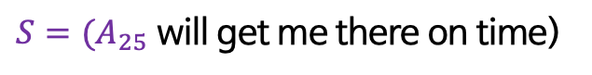
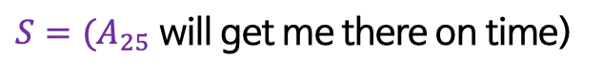
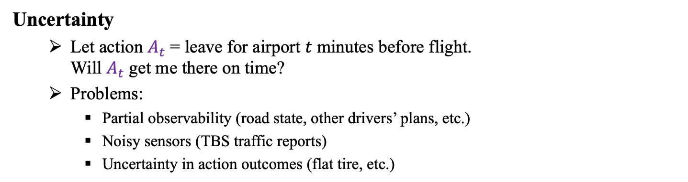
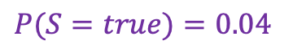
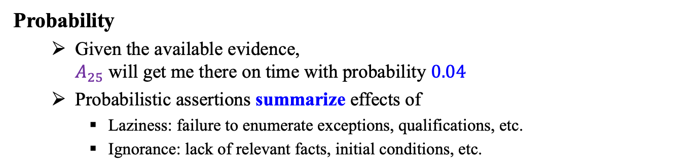

Uncertainty and Probability
Uncertainty
Let action $A_{t}$ = leave for airport $t$ minutes before flight. Will $A_{t}$ get me there on time?
Problems:
Partial observability (road state, other drivers’ plans, etc.)
Noisy sensors (TBS traffic reports)
Uncertainty in action outcomes (flat tire, etc.)
$S=(A_{25}$ will get me there on time)
Probability
Given the available evidence, $A_{25}$ will get me there on time with probability $0.04$
Probabilistic assertions summarize effects of
Laziness: failure to enumerate exceptions, qualifications, etc.
Ignorance: lack of relevant facts, initial conditions, etc.
$S=(A_{25}$ will get me there on time)
$P(S=true)=0.04$

Slide 5
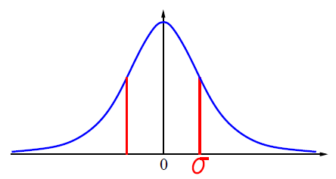
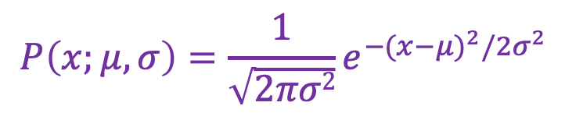
Probability Distribution
Probability for continuous variables
Gaussian density
$$P\left(x;μ,σ\right)=\frac{1}{\sqrt{2πσ2}}e^{{−(x−μ)}^{2}/{2σ}^{2}}$$

Slide 6
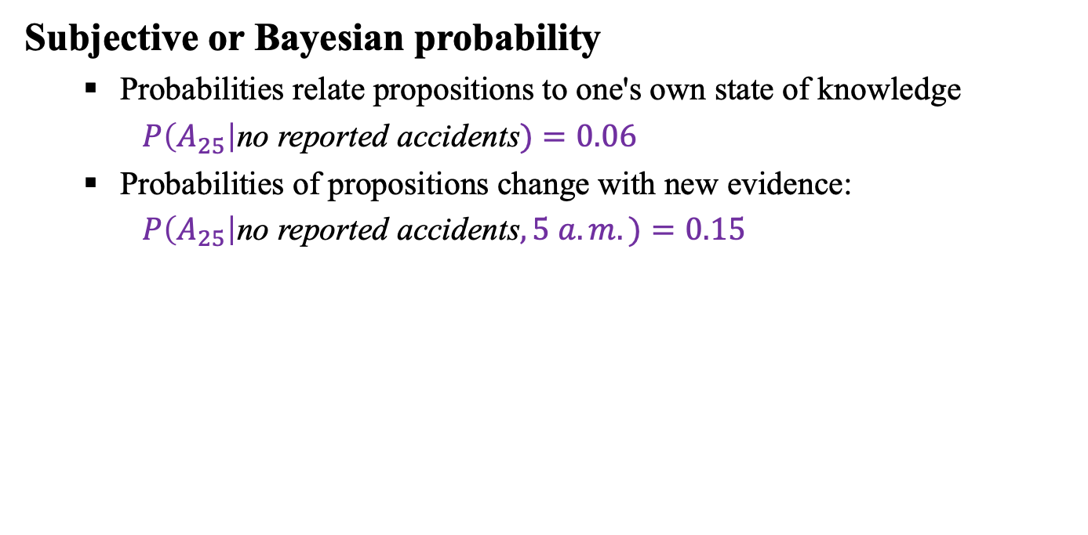
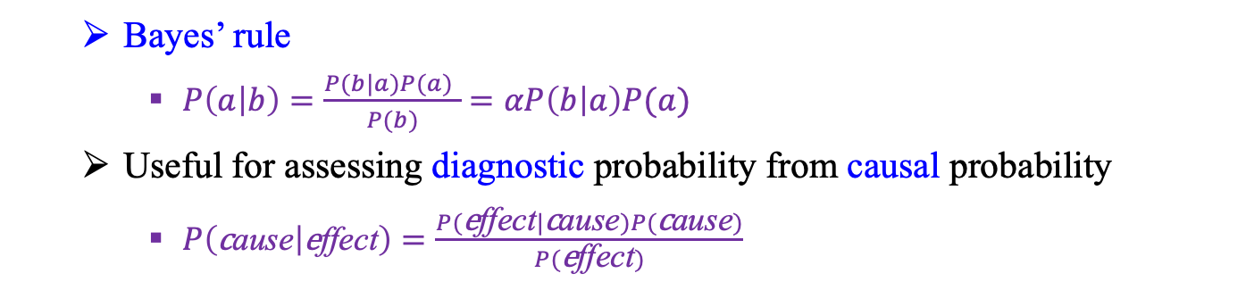
Bayesian Probability
Subjective or Bayesian probability
Probabilities relate propositions to one's own state of knowledge
$P\left(A_{25}\right|\text{no} \text{reported} \text{accidents})=0.06$
Probabilities of propositions change with new evidence:
$P\left(A_{25}\right|\text{no} \text{reported} \text{accidents}, 5 a.m.)=0.15$
Bayes’ rule
$P\left(a | b\right)=\frac{P(b|a)P(a) }{P(b)}$ $=αP\left(b | a\right)P(a)$
Useful for assessing diagnostic probability from causal probability
$P\left(\text{c}\text{ause} | \text{e}\text{ffect}\right)=\frac{P(\text{e}\text{ffect}|\text{c}\text{ause})P(\text{c}\text{ause})}{P(\text{e}\text{ffect})}$

Slide 7
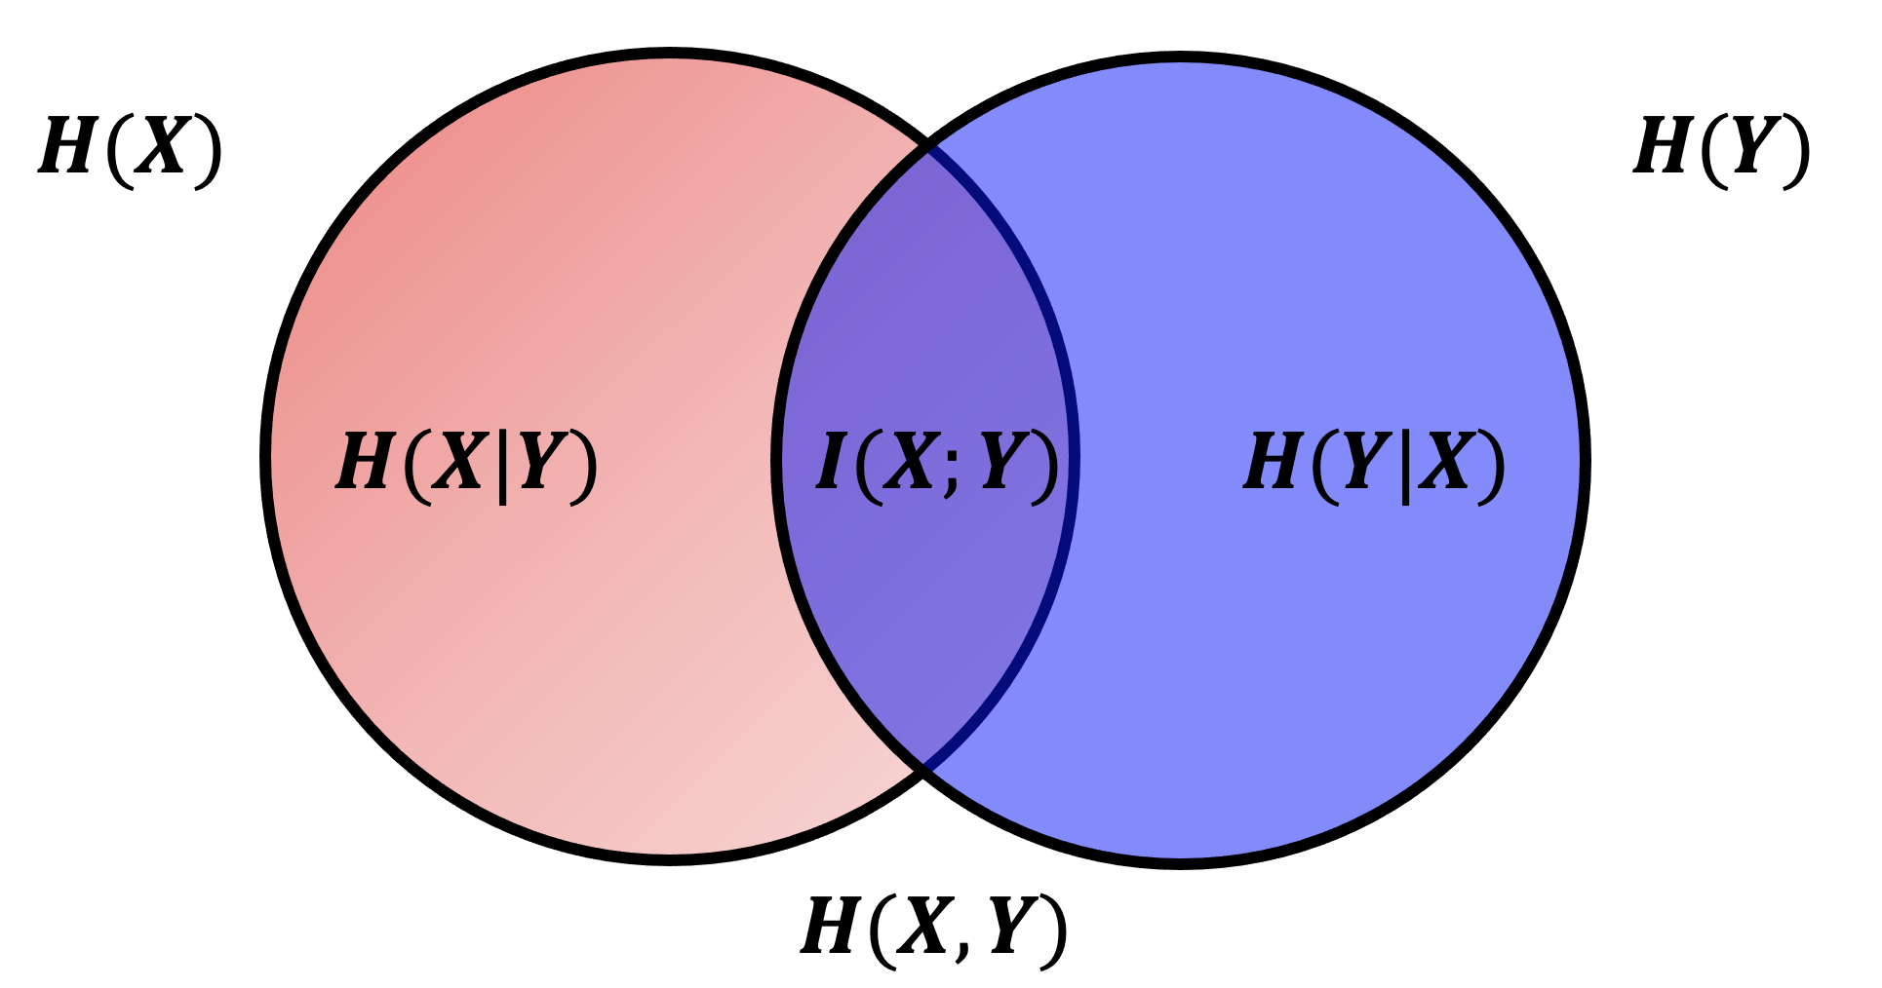
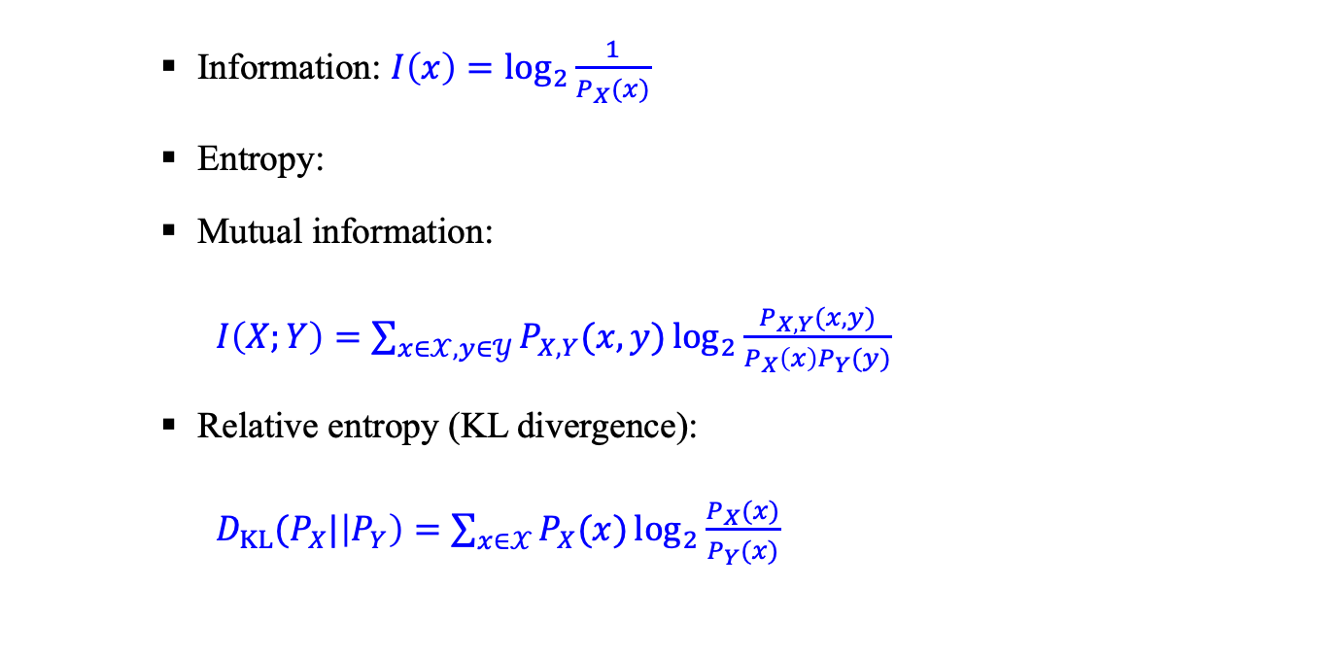
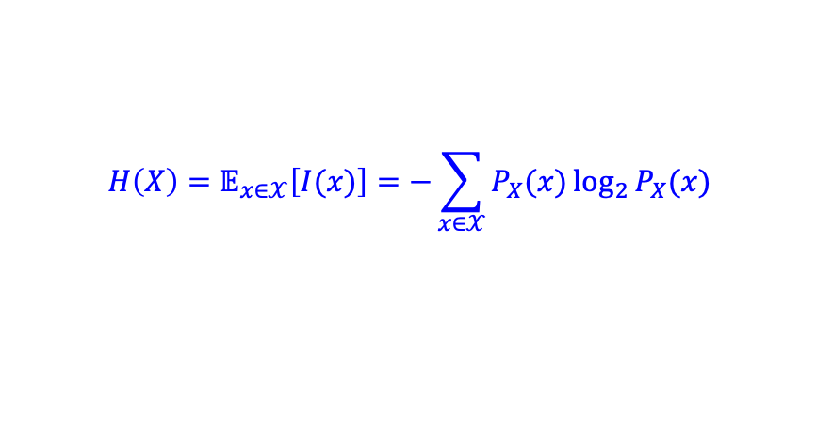
Information Theory
Information: $I\left(x\right)=\log_{2}{\frac{1}{P_{X}(x)}}$
Entropy:
Mutual information:
$I\left(X;Y\right)=\sum_{x∈𝒳,y∈𝒴}{P_{X,Y}(x,y)\log_{2}{\frac{P_{X,Y}(x,y)}{P_{X}\left(x\right)P_{Y}(y)}}}$
Relative entropy (KL divergence):
$D_{KL}(P_{X}|\left|P_{Y}\right)=\sum_{x∈𝒳}{P_{X}(x)\log_{2}{\frac{P_{X}(x)}{P_{Y}(x)}}}$
$$H\left(X\right)=𝔼_{x∈𝒳}\left[I(x)\right]=−\sum_{x∈𝒳}{P_{X}(x)\log_{2}{P_{X}(x)}}$$

Slide 8
Outline (Lecture 10)
10.1 Acting under Uncertainty .................................
10.2 Basic Probability Notation ...............................
10.3 Inference Using Full Joint Distribution ...........
10.4 Independence and Bayes’ Rule ........................
10.5 Information Theory ..........................................
Additional Materials ................................................
Summary ..................................................................
9
15
26
30
36
43
47

Slide 9
10.1 Acting under Uncertainty

Slide 10
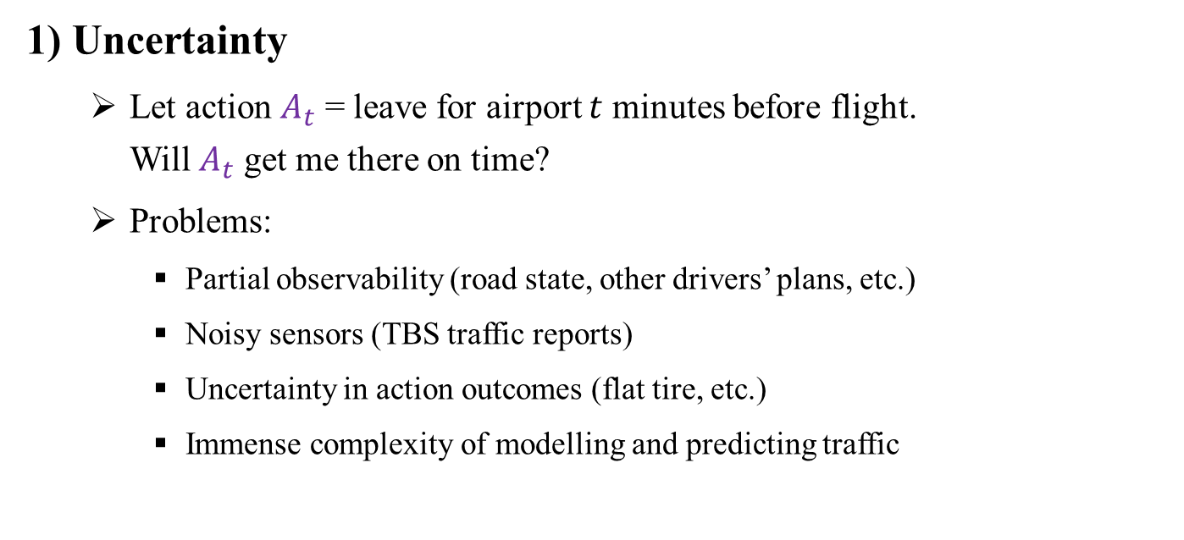
10.1 Acting under Uncertainty (1/5)
1) Uncertainty
Let action $A_{t}$ = leave for airport $t$ minutes before flight. Will $A_{t}$ get me there on time?
Problems:
Partial observability (road state, other drivers’ plans, etc.)
Noisy sensors (TBS traffic reports)
Uncertainty in action outcomes (flat tire, etc.)
Immense complexity of modelling and predicting traffic

Slide 11
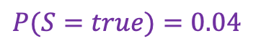
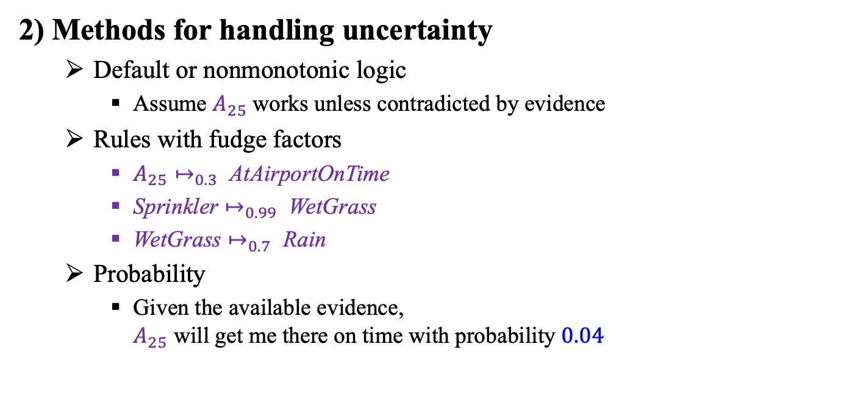
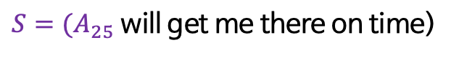
10.1 Acting under Uncertainty (2/5)
2) Methods for handling uncertainty
Default or nonmonotonic logic
Assume $A_{25}$works unless contradicted by evidence
Rules with fudge factors
$A_{25}↦_{0.3} \text{AtAirportOnTime}$
$\text{Sprinkler}↦_{0.99} \text{WetGrass}$
$\text{WetGrass}↦_{0.7} \text{Rain}$
Probability
Given the available evidence, $A_{25}$ will get me there on time with probability $0.04$
$S=(A_{25}$ will get me there on time)
$P(S=true)=0.04$

Slide 12
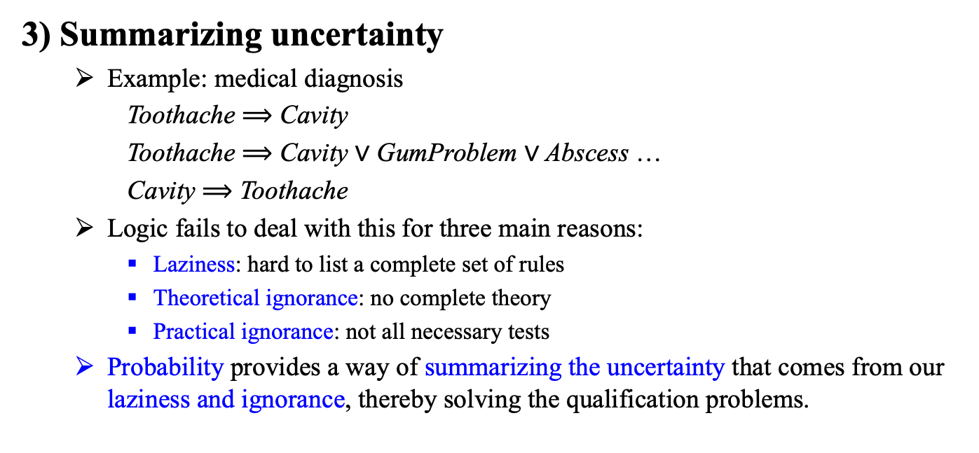
10.1 Acting under Uncertainty (3/5)
3) Summarizing uncertainty
Example: medical diagnosis
Toothache ⟹ Cavity
Toothache ⟹ Cavity $\text{∨}$ GumProblem $\text{∨}$ Abscess …
Cavity ⟹ Toothache
Logic fails to deal with this for three main reasons:
Laziness: hard to list a complete set of rules
Theoretical ignorance: no complete theory
Practical ignorance: not all necessary tests
Probability provides a way of summarizing the uncertainty that comes from our laziness and ignorance, thereby solving the qualification problems.

Slide 13
10.1 Acting under Uncertainty (4/5)
4) Uncertainty and rational decisions
Utility theory
An agent must first have preferences between the different possible outcomes of the various plans. We use utility theory to represent and reason with preferences.
utility being “the quality of being useful”
Decision theory
Preferences, as expressed by utilities, are combined with probabilities in the general theory of rational decisions called decision theory:
Decision theory = probability theory + utility theory
Maximum expected utility (MEU)
The fundamental idea of decision theory is that an agent is rational if and only if it chooses the action that yields the highest expected utility, averaged over all the possible outcomes of the action. This is the principle of maximum expected utility (MEU).

Slide 14
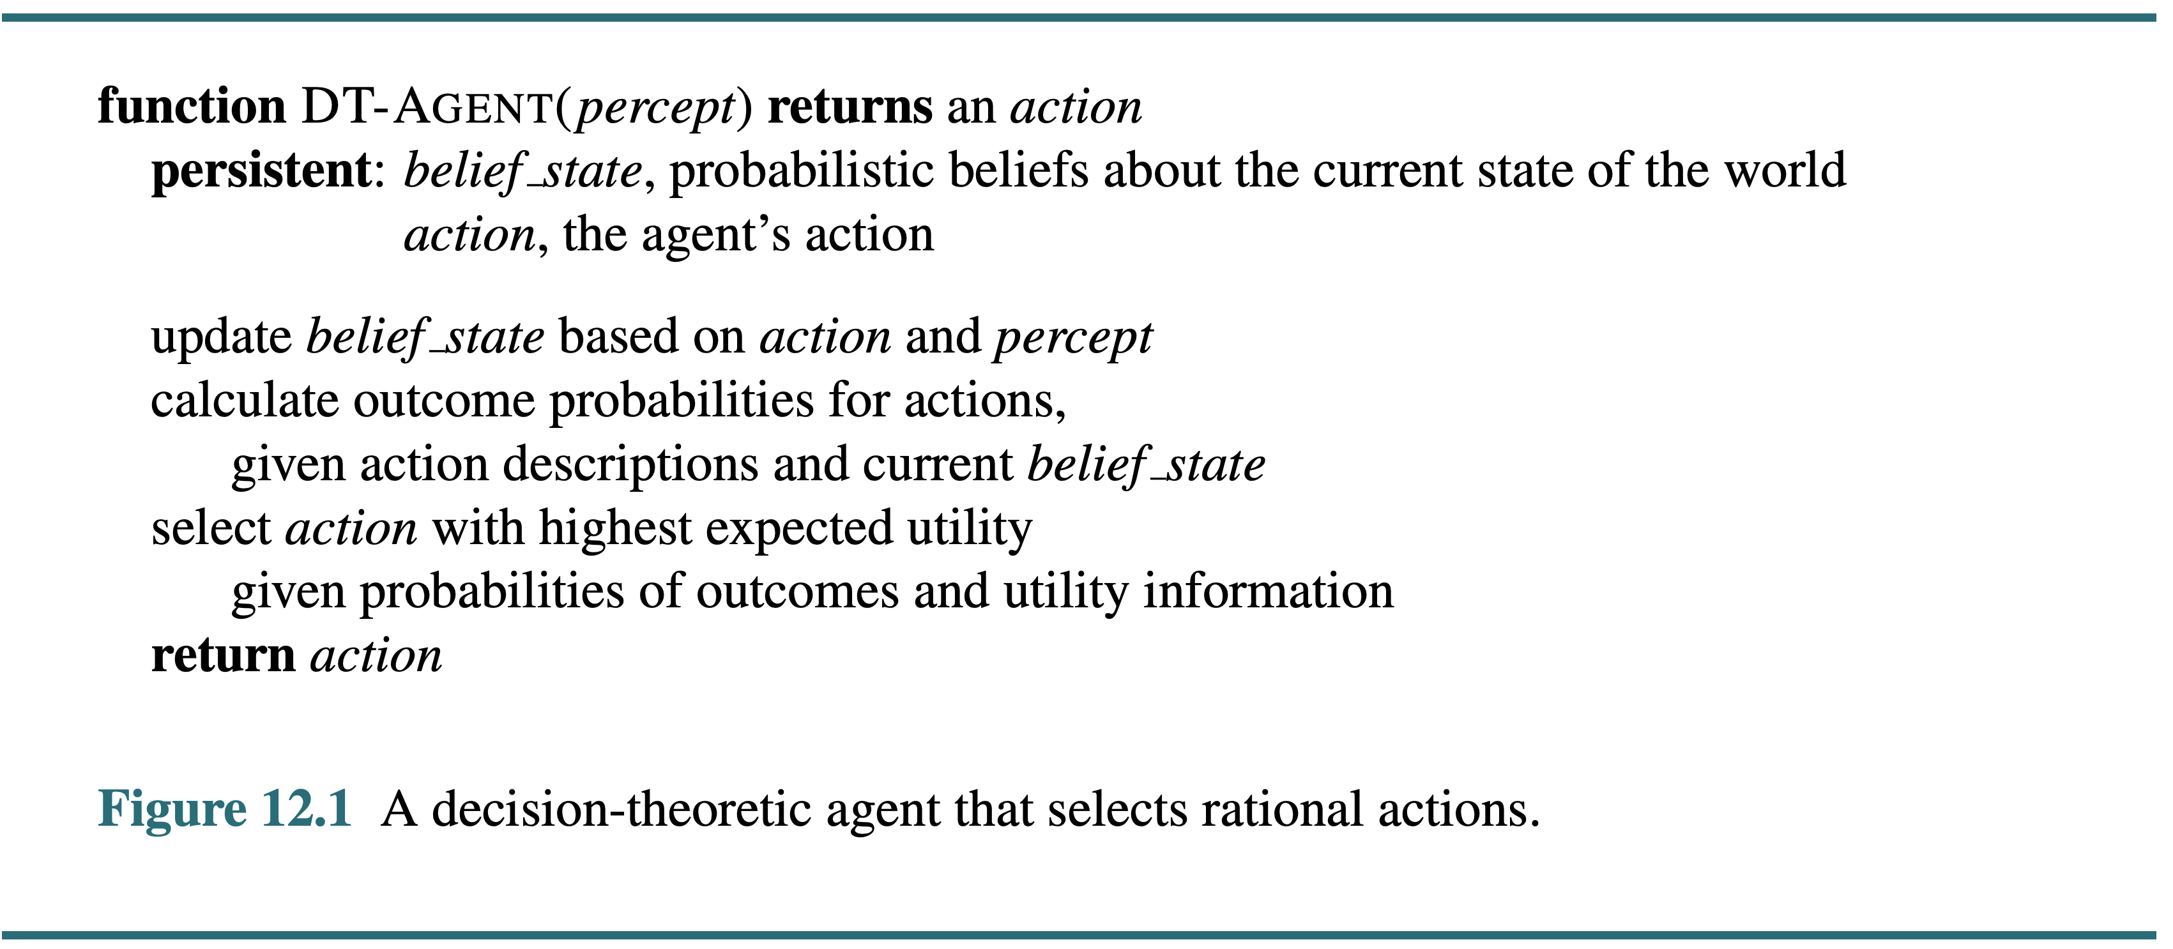
10.1 Acting under Uncertainty (5/5)
A decision-theoretic agent that selects rational actions

Slide 15
10.2 Basic Probability Notation

Slide 16
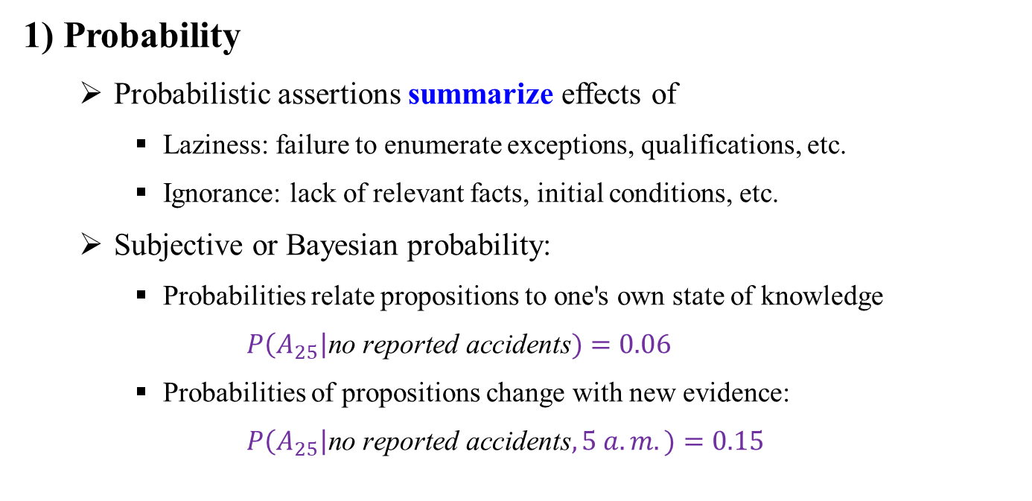
10.2 Basic Probability Notation (1/10)
1) Probability
Probabilistic assertions summarize effects of
Laziness: failure to enumerate exceptions, qualifications, etc.
Ignorance: lack of relevant facts, initial conditions, etc.
Subjective or Bayesian probability:
Probabilities relate propositions to one's own state of knowledge
$P\left(A_{25}\right|\text{no} \text{reported} \text{accidents})=0.06$
Probabilities of propositions change with new evidence:
$P\left(A_{25}\right|\text{no} \text{reported} \text{accidents}, 5 a.m.)=0.15$

Slide 17
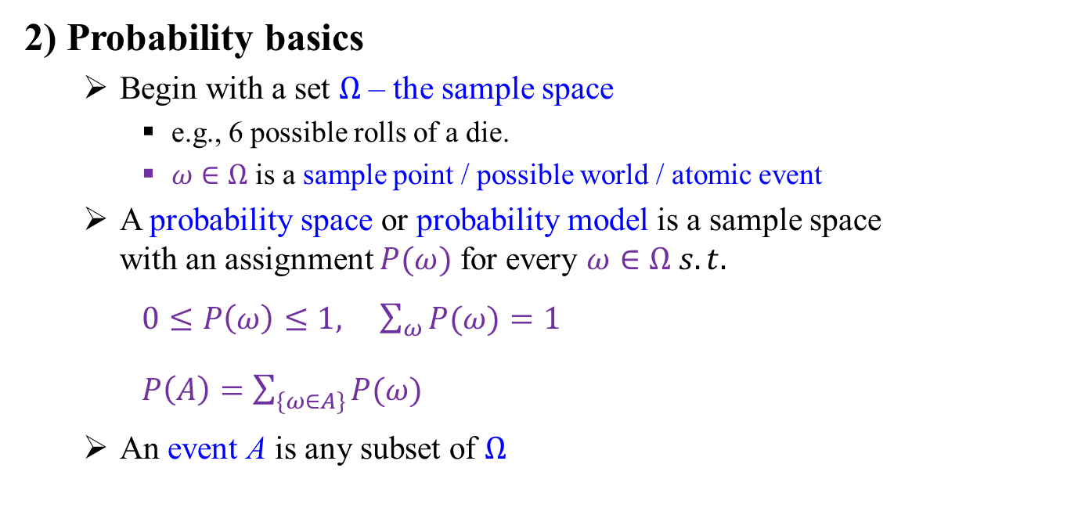
10.2 Basic Probability Notation (2/10)
2) Probability basics
Begin with a set $Ω$ – the sample space
e.g., 6 possible rolls of a die.
$ω∈Ω$ is a sample point / possible world / atomic event
A probability space or probability model is a sample space with an assignment $P(ω)$ for every $ω∈Ω s.t.$
$0≤P\left(ω\right)≤1, \sum_{ω}{P(ω)}=1$
$P\left(A\right)=\sum_{\{ω∈A\}}{P(ω)}$
An event A is any subset of $Ω$

Slide 18
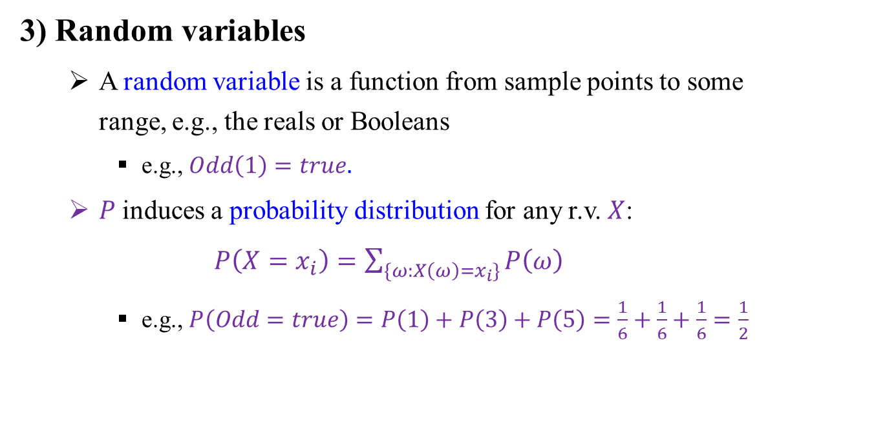
10.2 Basic Probability Notation (3/10)
3) Random variables
A random variable is a function from sample points to some range, e.g., the reals or Booleans
e.g., $Odd\left(1\right)=true.$
$P$induces a probability distribution for any r.v. $X$:
$P\left(X=x_{i}\right)=\sum_{\{ω:X\left(ω\right)=x_{i}\}}{P\left(ω\right)}$
e.g., $P\left(Odd=true\right)=P\left(1\right)+P\left(3\right)+P\left(5\right)=\frac{1}{6}+\frac{1}{6}+\frac{1}{6}=\frac{1}{2}$

Slide 19
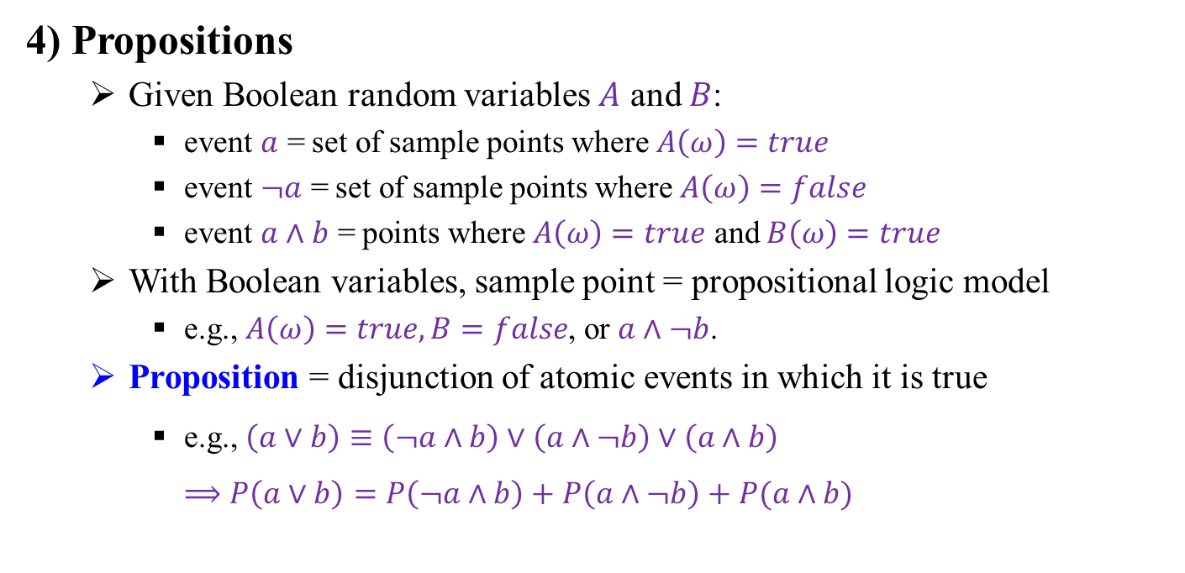
10.2 Basic Probability Notation (4/10)
4) Propositions
Given Boolean random variables $A$ and $B$:
event $a$ = set of sample points where $A\left(ω\right)=true$
event $¬a$ = set of sample points where $A\left(ω\right)=false$
event $a∧b$ = points where $A\left(ω\right)=true$ and $B\left(ω\right)=true$
With Boolean variables, sample point = propositional logic model
e.g., $A\left(ω\right)=true, B=false$, or $a∧¬b$.
Proposition = disjunction of atomic events in which it is true
e.g., $\left(a∨b\right)≡\left(¬a∧b\right)∨\left(a∧¬b\right)∨\left(a∧b\right)$ $⟹P\left(a∨b\right)=P\left(¬a∧b\right)+P\left(a∧¬b\right)+P(a∧b)$

Slide 20
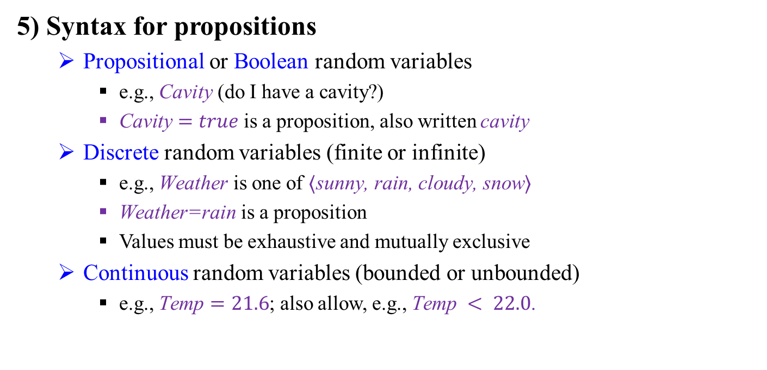
10.2 Basic Probability Notation (5/10)
5) Syntax for propositions
Propositional or Boolean random variables
e.g., $\text{Cavity}$ (do I have a cavity?)
$\text{Cavity}=true$is a proposition, also written $\text{cavity}$
Discrete random variables (finite or infinite)
e.g., $\text{Weather}$ is one of $⟨\text{sunny}\text{, }\text{rain}\text{, }\text{cloudy}\text{, }\text{snow}⟩$
$\text{Weather}\text{=}\text{rain}$is a proposition
Values must be exhaustive and mutually exclusive
Continuous random variables (bounded or unbounded)
e.g., $\text{Temp}=21.6$; also allow, e.g., $\text{Temp} < 22.0$.

Slide 21
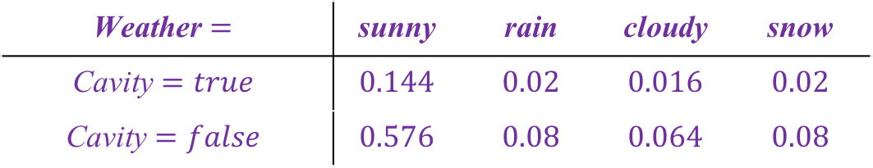
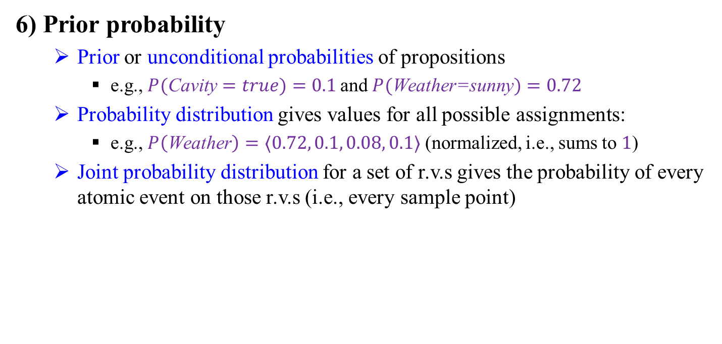
10.2 Basic Probability Notation (6/10)
6) Prior probability
Prior or unconditional probabilities of propositions
e.g., $P(\text{Cavity}=true)=0.1$and $P(\text{Weather}\text{=}\text{sunny})=0.72$
Probability distribution gives values for all possible assignments:
e.g., $P\left(\text{Weather}\right)=⟨0.72, 0.1, 0.08, 0.1⟩$ (normalized, i.e., sums to $1$)
Joint probability distribution for a set of r.v.s gives the probability of every atomic event on those r.v.s (i.e., every sample point)
$$\text{Weather}=$$ | $$\text{sunny}$$ | $$\text{rain}$$ | $$\text{cloudy}$$ | $$\text{snow}$$
$$\text{Cavity}=true$$ | $$0.144$$ | $$0.02$$ | $$0.016$$ | $$0.02$$
$$\text{Cavity}=false$$ | $$0.576$$ | $$0.08$$ | $$0.064$$ | $$0.08$$

Slide 22
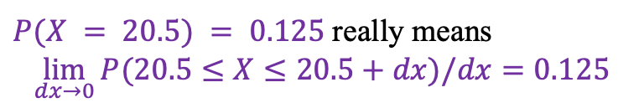
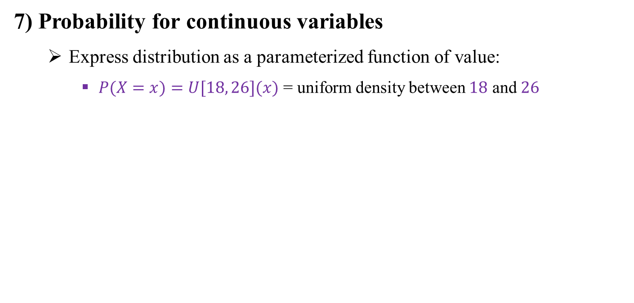
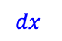
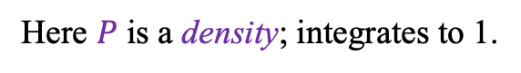
10.2 Basic Probability Notation (7/10)
7) Probability for continuous variables
Express distribution as a parameterized function of value:
$P(X=x)=U[18, 26](x)$ = uniform density between $18$ and $26$
Here $P$ is a $\text{density}$; integrates to 1.
$P(X = 20.5) = 0.125$really means
$$\lim_{dx→0}{P(20.5≤X≤20.5+dx)/dx}=0.125$$
18
$$dx$$
26
<출처> Stuart J. Russell and Peter Norvig (2021). Artificial Intelligence: A Modern Approach (4th Edition). Pearson

Slide 23
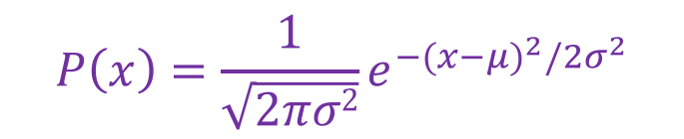
10.2 Basic Probability Notation (8/10)
8) Probability for continuous variables, contd.
Gaussian density
$$P\left(x\right)=\frac{1}{\sqrt{2πσ2}}e^{{−(x−μ)}^{2}/{2σ}^{2}}$$

Slide 24
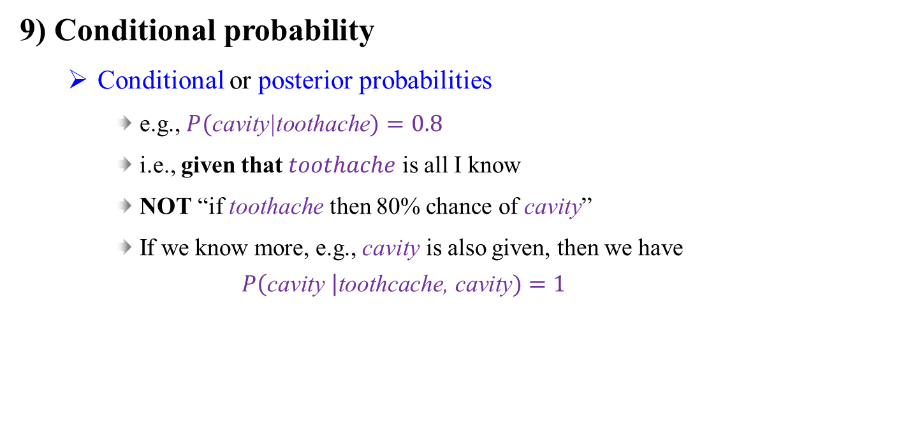
10.2 Basic Probability Notation (9/10)
9) Conditional probability
Conditional or posterior probabilities
e.g., $P(\text{cavity}\text{|}\text{toothache})=0.8$
i.e., given that $toothache$ is all I know
NOT “if $\text{toothache}$ then 80% chance of $\text{cavity}$”
If we know more, e.g., $\text{cavity}$ is also given, then we have $P\left(\text{cavity} \right|\text{toothcache}\text{, }\text{cavity})=1$

Slide 25
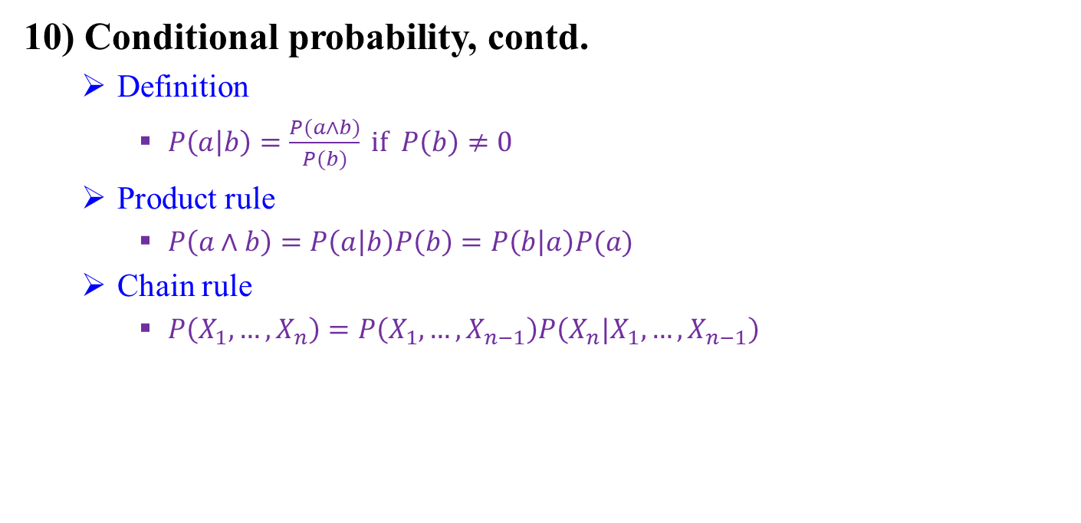
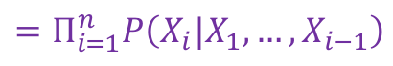
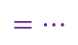
10.2 Basic Probability Notation (10/10)
10) Conditional probability, contd.
Definition
$P\left(a | b\right)=\frac{P(a∧b)}{P(b)} if P\left(b\right)≠0$
Product rule
$P\left(a∧b\right)=P\left(a | b\right)P\left(b\right)=P\left(b | a\right)P(a)$
Chain rule
$P\left(X_{1},…,X_{n}\right)=P\left(X_{1},…,X_{n−1}\right)P\left(X_{n}|X_{1},…,X_{n−1}\right)$
$$=P\left(X_{1},…,X_{n−2}\right)P\left(X_{n−1}|X_{1},…,X_{n−2}\right)P\left(X_{n}|X_{1},…,X_{n−1}\right)$$
$$=…$$
$$=Π_{i=1}^{n}P\left(X_{i}|X_{1},…,X_{i−1}\right)$$

Slide 26
10.3 Inference Using Full Joint
Distributions

Slide 27
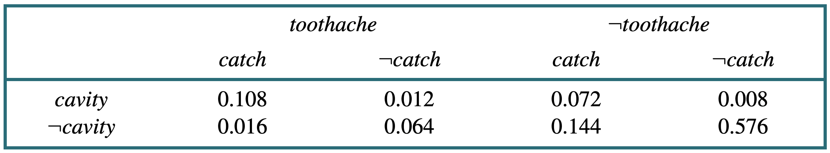
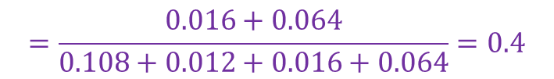
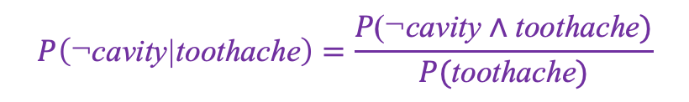
10.3 Inference Using Full Joint Distributions (1/3)
1) Inference by enumeration
$$P\left(\text{toothache}\right)=0.108+0.012+0.016+0.064=0.2$$
$$P\left(\text{cavity} \text{∨} \text{toothache}\right)=0.108+0.012+0.072+0.008+0.016+0.064=0.28$$
$$P\left(\text{¬}\text{cavity}\text{|}\text{toothache}\right)=\frac{P\text{(}\text{¬}\text{cavity} \text{∧} \text{toothache})}{P(\text{toothache})}$$
$$=\frac{0.016+0.064}{0.108+0.012+0.016+0.064}=0.4$$

Slide 28
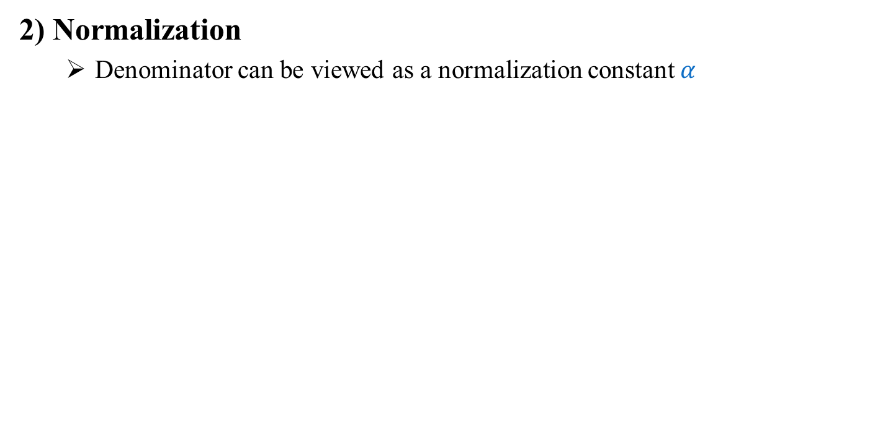
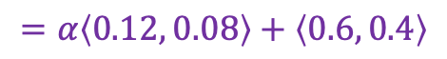
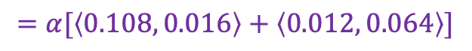
10.3 Inference Using Full Joint Distributions (2/3)
2) Normalization
Denominator can be viewed as a normalization constant $α$
$$P\left(\text{cavity}\text{|}\text{toothache}\right)=αP(\text{C}\text{avity}\text{, }\text{toochache})$$
$$=α[P\left(\text{C}\text{avity}\text{, }\text{toochache}\text{, }\text{catch}\right)+P\left(\text{C}\text{avity}\text{, }\text{toothache}\text{, ¬}\text{catch}\right)]$$
$$=α[\left\langle 0.108, 0.016\right\rangle +\left\langle 0.012, 0.064\right\rangle ]$$
$$=α\left\langle 0.12, 0.08\right\rangle +\left\langle 0.6, 0.4\right\rangle$$

Slide 29
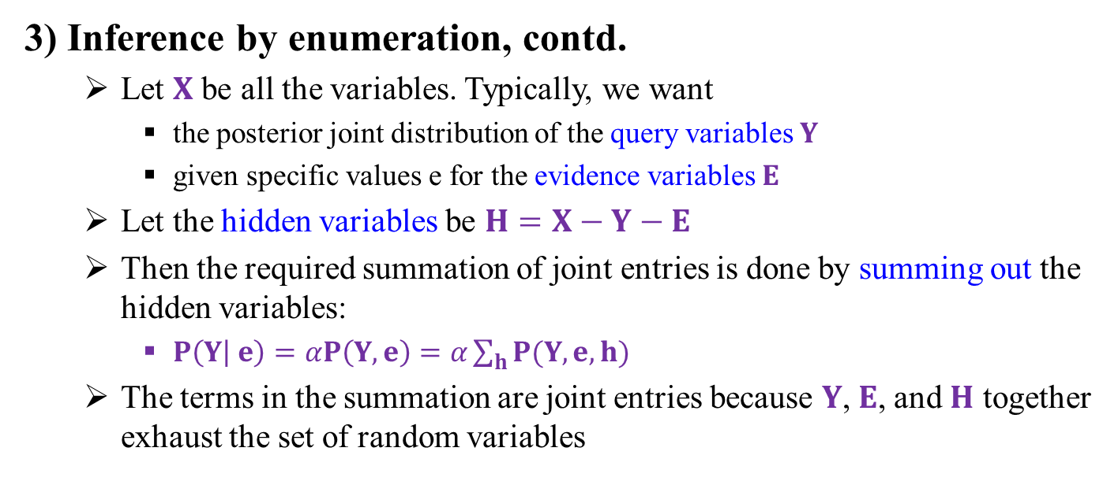
10.3 Inference Using Full Joint Distributions (3/3)
3) Inference by enumeration, contd.
Let $X$ be all the variables. Typically, we want
the posterior joint distribution of the query variables $Y$
given specific values e for the evidence variables $E$
Let the hidden variables be $H=X−Y−E$
Then the required summation of joint entries is done by summing out the hidden variables:
$P\left(Y | e\right)=αP\left(Y,e\right)=α\sum_{h}{P(Y,e,h)}$
The terms in the summation are joint entries because $Y$,$E$, and $H$ together exhaust the set of random variables

Slide 30
10.4 Independence and Bayes’ Rule

Slide 31
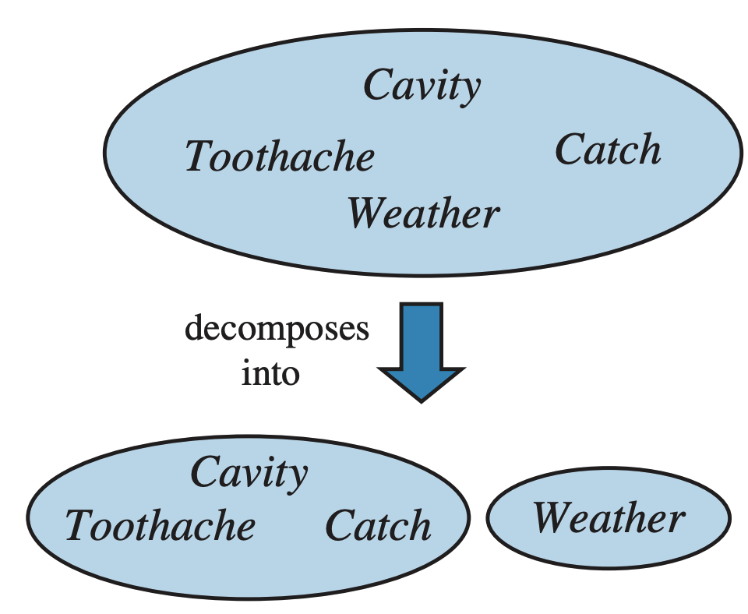
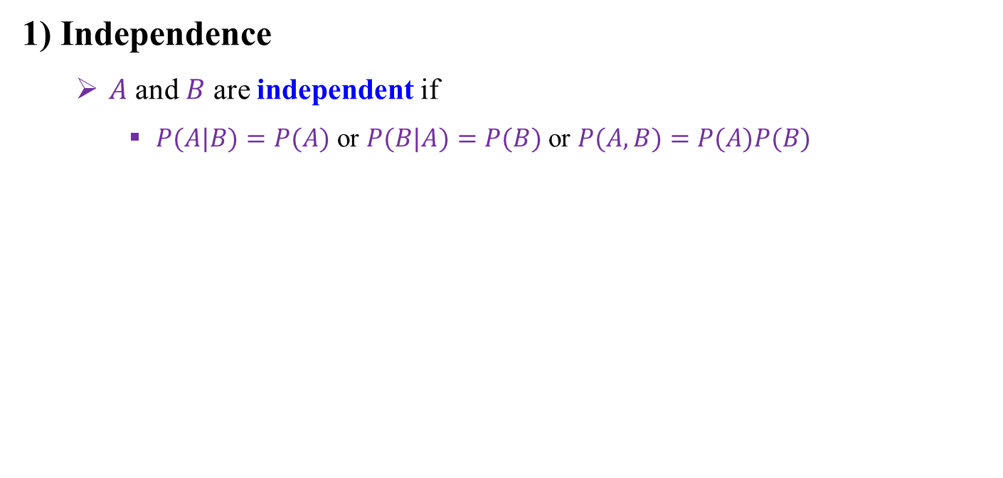
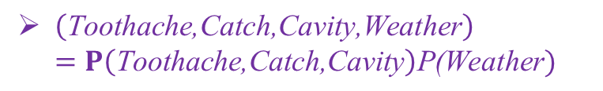
10.4 Independence and Bayes’ Rule (1/5)
1) Independence
$A$ and $B$ are independent if
$P(A|B)=P(A)$ or $P(B|A)=P(B)$or $P(A,B)=P(A)P(B)$
$\left(\text{Toothache}\text{,}\text{Catch}\text{,}\text{Cavity}\text{,}\text{Weather}\right)$ $=P\left(\text{Toothache}\text{,}\text{Catch}\text{,}\text{Cavity}\right)\text{P}\text{(}\text{Weather})$

Slide 32
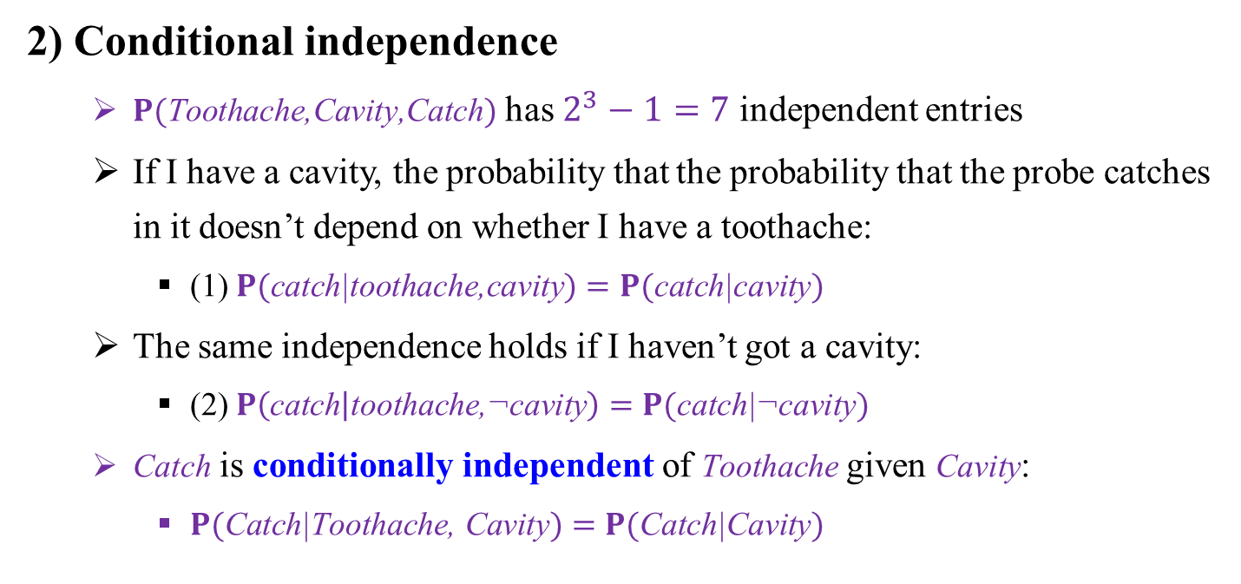
10.4 Independence and Bayes’ Rule (2/5)
2) Conditional independence
$P(\text{Toothache}\text{,}\text{Cavity}\text{,}\text{Catch})$ has $2^{3}−1=7$ independent entries
If I have a cavity, the probability that the probability that the probe catches in it doesn’t depend on whether I have a toothache:
(1) $P(\text{catch}\text{|}\text{toothache}\text{,}\text{cavity})=P(\text{catch}\text{|}\text{cavity})$
The same independence holds if I haven’t got a cavity:
(2) $P\left(\text{catch} | \text{toothache}\text{,¬}\text{cavity}\right)=P(\text{catch}\text{|¬}\text{cavity})$
$\text{Catch}$ is conditionally independent of $\text{Toothache}$ given $\text{Cavity}$:
$P(\text{Catch}\text{|}\text{Toothache}\text{, }\text{Cavity})=P(\text{Catch}\text{|}\text{Cavity})$

Slide 33
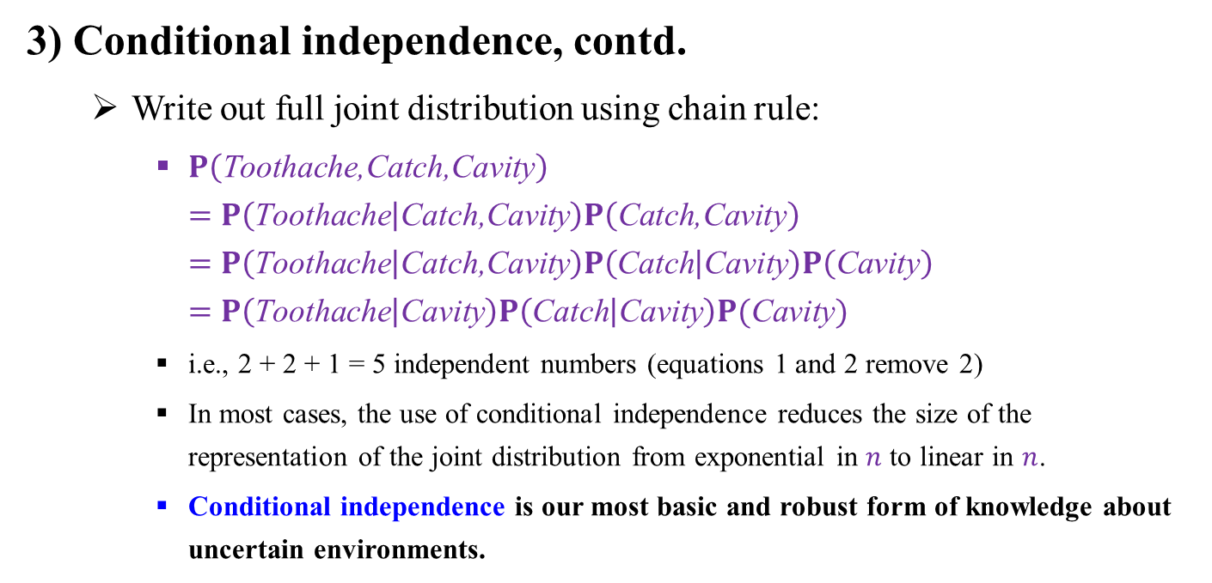
10.4 Independence and Bayes’ Rule (3/5)
3) Conditional independence, contd.
Write out full joint distribution using chain rule:
$P\left(\text{Toothache}\text{,}\text{Catch}\text{,}\text{Cavity}\right)$ $=P\left(\text{Toothache} | \text{Catch}\text{,}\text{Cavity}\right)P\left(\text{Catch}\text{,}\text{Cavity}\right)$ $=P\left(\text{Toothache} | \text{Catch}\text{,}\text{Cavity}\right)P\left(\text{Catch} | \text{Cavity}\right)P\left(\text{Cavity}\right)$ $=P\left(\text{Toothache} | \text{Cavity}\right)P\left(\text{Catch} | \text{Cavity}\right)P(\text{Cavity})$
i.e., 2 + 2 + 1 = 5 independent numbers (equations 1 and 2 remove 2)
In most cases, the use of conditional independence reduces the size of the representation of the joint distribution from exponential in $n$ to linear in $n$.
Conditional independence is our most basic and robust form of knowledge about uncertain environments.

Slide 34
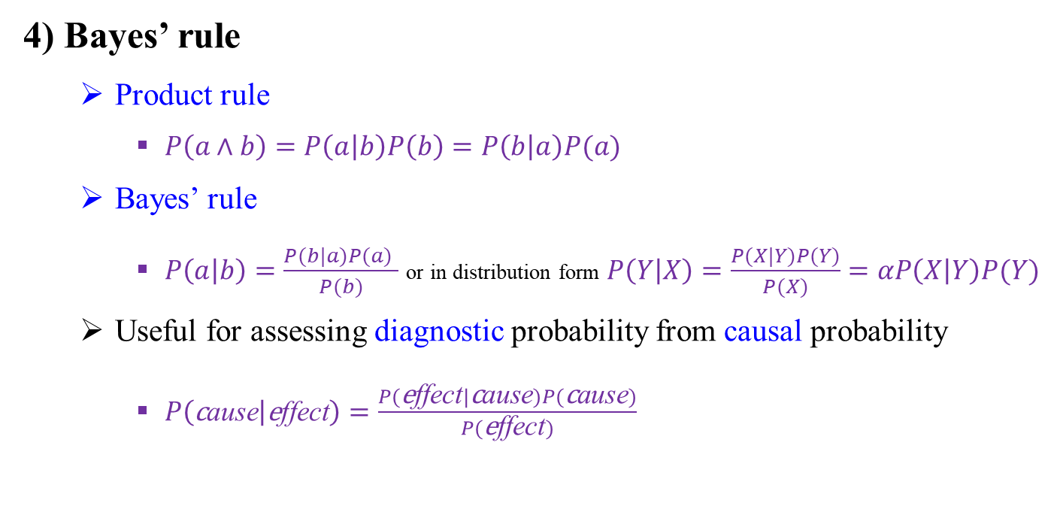
10.4 Independence and Bayes’ Rule (4/5)
4) Bayes’ rule
Product rule
$P\left(a∧b\right)=P\left(a | b\right)P\left(b\right)=P\left(b | a\right)P(a)$
Bayes’ rule
$P\left(a | b\right)=\frac{P(b|a)P(a) }{P(b)}$ or in distribution form $P\left(Y | X\right)=\frac{P(X|Y)P(Y)}{P(X)}=αP\left(X | Y\right)P(Y)$
Useful for assessing diagnostic probability from causal probability
$P\left(\text{c}\text{ause} | \text{e}\text{ffect}\right)=\frac{P(\text{e}\text{ffect}|\text{c}\text{ause})P(\text{c}\text{ause})}{P(\text{e}\text{ffect})}$

Slide 35
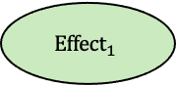
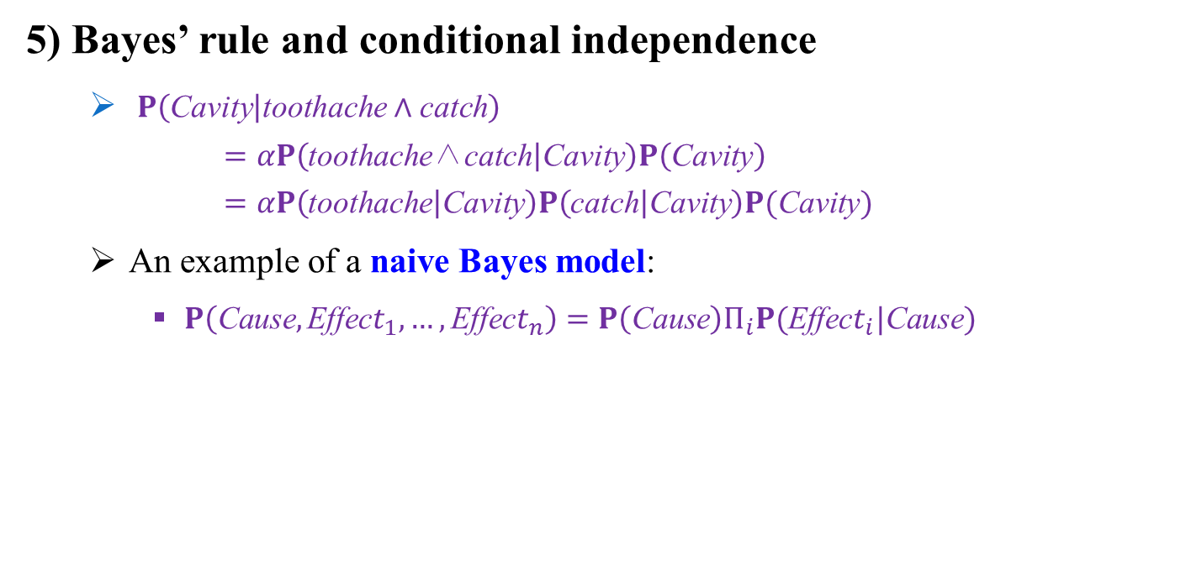
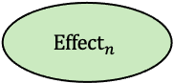
10.4 Independence and Bayes’ Rule (5/5)
5) Bayes’ rule and conditional independence
$P\left(\text{Cavity} | \text{toothache}∧\text{catch}\right)$ $=αP\left(\text{toothache}\text{∧}\text{catch} | \text{Cavity}\right)P\left(\text{Cavity}\right)$ $=αP\left(\text{toothache} | \text{Cavity}\right)P\left(\text{catch} | \text{Cavity}\right)P(\text{Cavity})$
An example of a naive Bayes model:
$P\left(\text{C}\text{ause},\text{E}\text{ffec}t_{1},…,\text{E}\text{ffec}t_{n}\right)=P\left(\text{C}\text{ause}\right)Π_{i}P(\text{E}\text{ffec}t_{i}|\text{C}\text{ause})$
Cavity
Cause
…
Toothache
Catch
$${Effect}_{1}$$
$${Effect}_{n}$$

Slide 36
10.5 Information Theory

Slide 37




10.5 Information Theory (1/6)
What is information? How to quantify the information?
Shannon’s information theory deals with limits on data compression (source coding) and reliable data transmission (channel coding)
How much can data can be compressed?
How fast can data be reliably transmitted over a noisy channel?
Claude Elwood Shannon (1916-2001)
Small information content
Large information content
<출처> ECE587, Information Theory, Duke University

Slide 38

10.5 Information Theory (2/6)
Notation
Random variable: $X$
Sample value of a random variable: $x$
Set of possible sample values $x$ of $X$: $𝒳$
Probability mass function (PMF) of discrete $X$: $P_{X}(x)$
Probability density function (PDF) of continuous $X$: $p_{X}(x)$
Information and Entropy
Information (Uncertainty): $I\left(x\right)=\log_{2}{\frac{1}{P_{X}(x)}}$
Entropy: $H\left(X\right)=𝔼_{x∈𝒳}\left[I(x)\right]=−\sum_{x∈𝒳}{P_{X}(x)\log_{2}{P_{X}(x)}}$ bits
A measure of the average uncertainty associated with a random variable
→ always non-negative!
Entropy is a lower bound on the number of bits need to represent a random variable

Slide 39




10.5 Information Theory (3/6)
A simple example of entropy
$$H\left(X\right)=𝔼_{x∈𝒳}\left[I(x)\right]=−\sum_{x∈𝒳}{P_{X}(x)\log_{2}{P_{X}(x)}}$$
High entropy means high disorder and low energy!
When a random variable has a uniform distribution, the system has the highest entropy!
P(blue): 1, P(green): 0
Entropy: $H\left(X\right)=\left(−\log_{2}{1}\right)×4=0$
P(blue): 0.75, P(green): 0.25
Entropy: $H\left(X\right)=\left(−\log_{2}{0.75}\right)×3−\log_{2}{0.25}=3.245$
P(blue): 0.5, P(green): 0.5
Entropy: $H\left(X\right)=\left(−\log_{2}{0.5}\right)×4=4$

Slide 40

10.5 Information Theory (4/6)
Joint entropy
The entropy of two discrete random variables $X,Y$ with joint PMF $P_{X,Y}\left(x,y\right)$
$$H\left(X,Y\right)=−\sum_{x∈𝒳,y∈𝒴}{P_{X,Y}(x,y)\log_{2}{P_{X,Y}(x,y)}}$$
Property: $H\left(X,Y\right)≤H\left(X\right)+H(Y)$
Conditional entropy
Entropy of a random variable given another random variable
There are various ways of writing this equation
$$H\left(Y|X\right)=−\sum_{x∈𝒳,y∈𝒴}{P_{X,Y}\left(x,y\right)\log_{2}{P_{Y|X}(y|x)}}$$

Slide 41







10.5 Information Theory (5/6)
Mutual Information
Measure of the amount of information that one random variable contains about another random variable
$$I\left(X;Y\right)=\sum_{x∈𝒳,y∈𝒴}{P_{X,Y}(x,y)\log_{2}{\frac{P_{X,Y}(x,y)}{P_{X}\left(x\right)P_{Y}(y)}}}$$
Useful expression: $I\left(X;Y\right)=H\left(X\right)−H\left(X | Y\right)=H\left(Y\right)−H(Y|X)$
$$H(X)$$
$$H(Y)$$
$$H(X|Y)$$
$$I(X;Y)$$
$$H(Y|X)$$
$$H(X,Y)$$

Slide 42

10.5 Information Theory (6/6)
Cross Entropy
Measure of the distribution $P_{Y}$ relative to a distribution $P_{X}$ over a given set
$$H\left(P_{X},P_{Y}\right)=𝔼_{x∈𝒳}\left[\log_{2}{P_{Y}(x)}\right]=−\sum_{x∈𝒳}{P_{X}(x)\log_{2}{P_{Y}(x)}}$$
Relative Entropy (Kullback-Leibler divergence)
Measure of divergence between two distributions $P_{X}\left(x\right)$ and $P_{Y}\left(y\right)$
$$D_{KL}(P_{X}|\left|P_{Y}\right)=𝔼_{x∈𝒳}\left[\log_{2}{\frac{P_{X}(x)}{P_{Y}(x)}}\right]=\sum_{x∈𝒳}{P_{X}(x)\log_{2}{\frac{P_{X}(x)}{P_{Y}(x)}}}$$
Property 1. Non-negativity: $D_{KL}(P_{X}|\left|P_{Y}\right)≥0$ (if $P_{X}$= $P_{Y}$, $D_{KL}(P_{X}|\left|P_{Y}\right)=0$)
Property 2. Non-symmetricity: $D_{KL}(P_{X}|\left|P_{Y}\right)≠D_{KL}(P_{Y}|\left|P_{X}\right)$

Slide 43
Additional Materials

Slide 44
Probability Distribution & Statistical Mechanics
States of low energy have a higher probability of occurrence than the states of high energy.
As the temperature T is reduced, the probability is concentrated on a smaller subset of low-energy states.

Slide 45
Markov Chain Monte Carlo (MCMC), Metropolis Algorithm

Slide 46
Markov Chain Monte Carlo (MCMC), Gibbs Sampling

Slide 47
Summary
Uncertainty arises because of both laziness and ignorance. It is inescapable in nondeterministic, or partially observable environments.
Probabilities express the agent’s inability to reach a definite decision regarding the truth of a sentence. Probabilities summarize the agent’s beliefs relative to the evidence.
Basic probability statements include prior probabilities and conditional probabilities over simple and complex propositions.
The full joint probability distribution specifies the probability of each complete assignment of values to random variables.
Bayes’ rule allows unknown probabilities to be computed from known conditional probabilities, usually in the causal direction.
Conditional independence brought about by direct causal relationships in the domain might allow the full joint distribution to be factored into smaller, conditional distributions.
Information theory: information, entropy, joint entropy, conditional entropy, mutual information, cross, entropy, relative entropy (KL divergence)

